Slide 1
Some Size factors
Introduction to Software Engineering

Slide 2
Some Size Factors
Here, the level of effort devoted to software development and maintenance is discussed.
The distribution of effort among activities is presented; and size categories for software projects are described.

Slide 3
Total Effort Devoted to Software
Figures from United States in 1980
Total amount of aspects of computing is 5% of GNP which is about 130$ billion.
Further estimated that computing revenues will be 8% of GNP in 1985.
The demand for software technologists exceeds the supply by 7,50,000 to 2,000, 000 people by 1990.
Thus the major goal of Software Engineering is to provide tools and techniques to increase the productivity of the available software engineers.

Slide 4
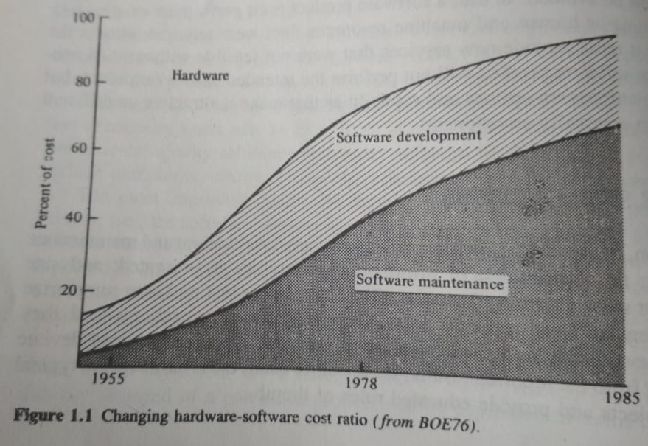
Total Effort Devoted to Software

Slide 5
Total Effort Devoted to Software
Figure says the software is the labour-intensive activity, and personnel costs constantly increasing. Similarly, software maintenance is an increasing portion of software cost as with passing time more software accumulates.

Slide 6
Distribution of Effort
The typical lifespan of software product is 1 – 3 years in development and 5 to 15 years in use (maintenance).
The distribution of effort between development and maintenance has been variously reported as 40/60, 30/70, and even 10/90.
Software Maintenance involves 3 types of activities: enhancing the capabilities of the product, adapting for new processing environments, and correcting bugs.

Slide 7
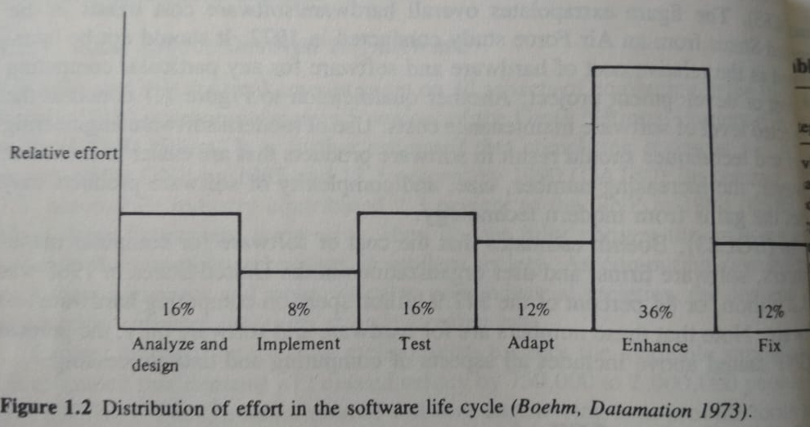

Slide 8
Project Size Categories
Trivial projects
It involves 1 programmer.
Working part time Few days or few weeks and results 500 statements packaged with 10-20 subroutines.
Such programs often develops personal software.
Little need of formal analysis, design, test planning or supporting documents.

Slide 9
Project Size Categories contd.
Small projects
It also involves 1 programmer.
Time 1 – 6 months and results 1000-2000 lines of code packaged with 25-50 subroutines.
Such programs often includes scientific applications written by engineers to solve numerical problems, small commercial applications or student projects.
Proper analysis, design, test planning or supporting documents but degree of formality is much lesser than large projects.

Slide 10
Project Size Categories contd.
Medium-size projects
It also involves 2-5 programmers.
Time 1 – 2 years and results 10,000-50,000 lines of code packaged with 250-1000 subroutines.
Such programs often includes assemblers, compilers, small MIS, inventory management system
Certain degree of formality is required for analysis, design, test planning or supporting documents and some interaction is needed among programmers and communication with customers.

Slide 11
Project Size Categories contd.
Medium-size projects contd..
Use of systematic software engineering principles. It will result improved product quality, increased productivity, and better satisfaction of customer needs.
Most of the software development activities comes under this category.

Slide 12
Project Size Categories contd.
Large projects
It also involves 5-20 programmers of different teams having at least 5 programmers in each team.
Time 2 – 3 years and results 50,000-1,00,000 lines of code packaged in several subsystems.
Such programs often includes large compilers, small time sharing systems, database packages, real-time control systems
Interaction among programmers and communication with customers is truly crucial.

Slide 13
Project Size Categories contd.
Large projects contd..
Proper software engineering practices is initiated as the size and complexity of product increases and changes in requirement by both customer and developers frequently occurs as project evolves.

Slide 14
Project Size Categories contd.
Very large projects
It also involves 100-1000 programmers of different teams.
Time 4 – 5 years and results 1 million lines of code packaged in several subsystems.
Such programs often involves real-time processing, telecommunications and multi-tasking for example: large OS, large database systems, military command and control systems.
Brooks reports that the IBM OS named OS/360 was developed by 5000 programmers in 5 years, which contained 1 million LOC.

Slide 15
Project Size Categories contd.
Extremely large projects
It also involves 2000-5000 programmers of different teams.
Time 10 years and results 1 million lines of code packaged in several subsystems.
Such programs often involves. real-time processing, telecommunications and multi-tasking for example: air-traffic control system, ballistic missile etc.

Slide 16
Quality and Productivity Factors

Slide 17
Quality and Productivity Factors
Those who have written only small programs for personal use or homework exercises may find it difficult to understand the importance of systematic activities.
Observe that electrical engineers do not produce electronic circuits by soldering components together.
Software quality and programmer productivity can be improved by improving the process used to develop and maintain software products.
Some factors that influence quality and productivity are discussed now onwards.

Slide 18
Quality and Productivity Factors
Individual ability
Production & Maintenance are labour intensive activities thus direct functions of individual ability and effort
Two aspects to ability:
The general competence of the individual
Mean the basic ability to write correct computer programs. On the experiment by Sackman and others conducted in 1968 (SAC68) concludes there is a huge difference among programmers in their programming ability.
That’s why on a very large and extremely large projects the individual differences in programmer productivity will tend to average out.
But in small and medium size projects are extremely sensitive to the ability of programmer. They can’t afford low productivity.

Slide 19
Quality and Productivity Factors
Individual ability contd…
Familiarity of the individual with the particular application area
Competent data processing programmers are not usually competent in scientific application areas and vice versa.
Lack of familiarity with the application area can result in low productivity and poor quality.

Slide 20
Quality and Productivity Factors
Team communication
Programming has traditionally been regarded as an individual and private activity. Many programmers have low social needs and prefer to work alone.
On the other hand, increasing product size results in decreasing programmer productivity due to the increased complexity of interactions among program components, and due to the increased communication required among programmers, managers and customers the team needs to be social and communicative.
Brooks observed that communication paths among programmers grows as n(n-1)/2. where n is the number of programmers in a project team.

Slide 21
Quality and Productivity Factors
Product complexity
Complexities are categorized as: application programs, utility programs, and system-level programs.
Application programs have the highest productivity and system programs have the lowest productivity, as measured in lines of code per programmer-day.
Utility programs can be produced at a rate 5 to 10 times, and applications programs at a rate 25 to 100 times, that of systems programs.

Slide 22
Quality and Productivity Factors
Appropriate notations
In software engineering, the representation schemes are of fundamental importance.
Good notations can clarify the relationships and interactions of interest, while poor notations complicate and interfere with good practice.
Programming languages provide concise notations for the implementation phase of software development, but there are no widely accepted notations for stating functional requirements, design specifications, test plans, or performance criteria.
Several notations have been developed in this area, but there are no universally accepted notations in software engineering.

Slide 23
Quality and Productivity Factors
Systematic approaches
In software development and maintenance practices needs systematic approaches when we need a quality product.
No customer wants to compromise with quality if truly understand the need of software in their professional automation of work.
We needs to stuck with some systematic approach towards software development and maintenance to move towards quality and productivity in this everyday competitive market.

Slide 24
Quality and Productivity Factors
Change control
The flexibility of software is a great strength and also a great source of difficulty in software engineering.
Requirements can also change due to change due to poor understanding of the problem, or external economic and political factors beyond the control of customer or developer. Some projects experience constantly changing requirements, which can quickly weaken project morale.
The devastating effects of constantly changing requirements can be minimized by planning for change and by formalizing the mechanism of change. Planning for a software project must include plans for change control.

Slide 25
Quality and Productivity Factors
Required Technology
The level of technology utilized on a software project accounts for such factors as the programming language, the machine environment, the programming practices, and the software tools.
Modern programming languages provides improved facilities for data definition and data usage, better modularization facilities, user defined exception handling, and facilities for concurrent programming.
IDE’s always motivate to be systematic and planned and always use modern practices of current scenario.

Slide 26
Quality and Productivity Factors
Required Reliability
Every software product must possesses a basic level of reliability. However, extreme reliability is gained only with great care in analysis, design, implementation, system testing, and maintenance of the software product.
Both human and machine resources are required to obtain increased reliability.
But this results in decreased productivity when productivity is measured in lines of code produced per programmer-month.

Slide 27
Quality and Productivity Factors
Problem understanding
When SE does not understand the application area and trouble communicating with customers.
Sometimes the customer is not the end user of the system, and the SE has no opportunity to investigate the user’s problem.
Sometimes the true nature of problem does not become visible until the software product, or some major portion of it, is constructed and operated. many more...
So careful planning, customer interviews, site observation, prototyping, a preliminary version of user’s manual etc can increase both customer and developer understanding of the problem can be solved.

Slide 28
Quality and Productivity Factors
Problem understanding contd…
Failure to understand the true nature of the problem to be solved is a common and difficult issue.
Often customers does not truly understand the nature of the problem and/ or does not understand the capabilities and limitations of the computers.
Often Software engineer does not understand the application area and has trouble communicating with the customer because of differences in educational backgrounds, viewpoint, and technical jargon.
Sometimes customer is not the end user’s of the system, and the software engineer has no opportunity to investigate the user’s problem.

Slide 29
Quality and Productivity Factors
Available time
While it might appear that a software project requiring 6 programmer-months of effort can be completed by 1 programmer in 6 months or by 6 programmers in 1 month, software projects are sensitive not only to total effort but also to elapsed time and the number of people involved.
Programmer productivity is also sensitive to the calendar time available for project completion.

Slide 30
Quality and Productivity Factors
Required Skills
1 programmer in 6 months OR 6 programmers in 1 month but the best aspect ratio will be 2 programmers in 3 months.
Programmer productivity is also sensitive to the calendar time available for project completion.
There is a quantitative evidence to suggest that development time cannot be compressed below about 75% of the nominal development time regardless of the personnel and resources expanded (BOE81).
Determining optimum staffing levels and proper elapsed times for various activities in software product development is an significant and difficult aspect of cost and resources estimation.

Slide 31
Quality and Productivity Factors
Required skills
The practice of software engineering requires a vast range of skills. Extracting information from customers, testing or debugging the process or product, problem solving skill-set, concentrating of every detail while implementation, preparation of external documentation etc.
Working with customers and other developers requires good oral and interpersonal communication skills.
All these skills are exercised within technical and managerial framework; software engineers must be technically competent and possess sufficient social skills to interact with managers, customers, and other engineers.

Slide 32
Quality and Productivity Factors
Facilities & resources
Most programmers receive their motivational rewards from the nature of the work itself and are thus quite sensitive to, and easily frustrated by, poor facilities and inadequate resources.
Software project managers must be efficient be effective in dealing with the factors that motivate and frustrate programmers if they are to maintain high product quality, high programmer productivity, and high job satisfaction.

Slide 33
Quality and Productivity Factors
Adequacy of training
Training is also highly required on some crucial non-technical aspects. In-fact some institutions offer courses that deal with those titles/ topics, but these institutions are fewer in numbers.
Boehm has described the skills most lacking in entry-level programmers (BOE76b). List includes inability to:
Develop and validate software requirements and design specifications.
Work within application area.
Perform software maintenance.
Work with project management techniques.
Work in groups.

Slide 34
Quality and Productivity Factors
Adequacy of training
Some reasons behind this lacking:
There is predictable time lag between educational supply and industrial demand.
Still now, most programmers have been trained as computer scientists, electrical engineers, accountants, or mathematicians, not as software engineers.
No motivation (not even in campus interviews) regarding analyzing, designing, constructing, testing, verifying, documenting, operating, and maintaining software products.

Slide 35
Quality and Productivity Factors
Management skills
Software projects are often supervised by managers who have little, if any, knowledge of software engineering.
Even managers experienced in management of computer hardware projects find software project management to be difficult due to differences in design methods, notations, development tools, and issue and concerns.
On the other hand, the practice of “promoting” technically competent individuals who have little management inclination and no management training into software project management often produces equally unsatisfactory results.
This may due to the low social needs of many software people and the need for good social skills in managers.

Slide 36
Quality and Productivity Factors
Appropriate goals
The primary goal of software engineering is development of software products that are appropriate for their intended use. Ideally, every software product should provide optimal levels of generality, efficiency, and reliability.
An appropriate trade-off between productivity and quality factors can be achieved by adhering to the goals and requirements established for the software product during project planning.

Slide 37
Quality and Productivity Factors
Rising expectations
Two interrelated aspects to rising expectations:
Concern for how much functionality, reliability, and performance can be provided by a given amount of effort.
Issue of fundamental limitations of software technology.
Dramatic advances in hardware technology have created the expectation that software technology will advance at an equally fast pace.

Slide 38
Managerial Issues

Slide 39
Managerial Issues
Technical & Managerial activities are equally important to the success of software project.
Managers also have crucial responsibility for ensuring that software products are delivered on time, within cost estimates, and that products exhibits the functional and quality attributes desired by the customer.
Other management responsibilities include developing business plans, recruiting customers, developing marketing strategies, and recruiting & training employees.

Slide 40
Definition issues
Project goals
Project scope
Project requirements
Project deliverables

Slide 41
Strategic issues
The project does not meet project selection criteria
Project is insufficiently funded
Lack of visible management support for the project.
Project communication has been ineffective.
Project management process has been too relaxed.

Slide 42
Resources issues
Project team lacks the skills to complete the project.
Project team is too large or too small.
Project team is poorly organized.
Project team is hampered by personal conflicts and internal politics.

Slide 43
Schedule issues
Project schedule is overly aggressive
Equipment delays have hampered project schedule
Technical issues
Technical needs and advances in technology have changed.
Dependencies issues
Business needs and circumstances have changed

